Slide 2
Overview
Part 1 - Storage Elements and Analysis
  Introduction to sequential circuits
  Types of sequential circuits
  Storage elements
    Latches
    Flip-flops
  Sequential circuit analysis
    State tables
    State diagrams
    Equivalent states
    Moore and Mealy Models
Part 2 - Sequential Circuit Design
Part 3 – State Machine Design
Chapter 5 - Part 1 <number>

Slide 3
Introduction to Sequential Circuits
Inputs
Outputs
Combina-tional
Logic
A Sequential circuit contains:
  Storage elements:
  Latches or Flip-Flops
  Combinational Logic:
    Implements a multiple-output switching function
    Inputs are signals from the outside.
    Outputs are signals to the outside.
    Other inputs, State or Present State, are signals from storage elements.
    The remaining outputs, Next State are inputs to storage elements.
Storage Elements
Next
State
State
Chapter 5 - Part 1 <number>

Slide 4
Introduction to Sequential Circuits
Combinatorial Logic
  Next state function
  Next State = f(Inputs, State)
  Output function (Mealy)
  Outputs = g(Inputs, State)
  Output function (Moore)
  Outputs = h(State)
Output function type depends on specification and affects the design significantly
Outputs
Inputs
Combina-tional
Logic
Storage Elements
Next
State
State
Chapter 5 - Part 1 <number>

Slide 5
Types of Sequential Circuits
Depends on the times at which:
  storage elements observe their inputs, and
  storage elements change their state
Synchronous
  Behavior defined from knowledge of its signals at discrete instances of time
  Storage elements observe inputs and can change state only in relation to a timing signal (clock pulses from a clock)
Asynchronous
  Behavior defined from knowledge of inputs an any instant of time and the order in continuous time in which inputs change
  If clock just regarded as another input, all circuits are asynchronous!
  Nevertheless, the synchronous abstraction makes complex designs tractable!
Chapter 5 - Part 1 <number>

Slide 6
Discrete Event Simulation
In order to understand the time behavior of a sequential circuit we use discrete event simulation.
Rules:
  Gates modeled by an ideal (instantaneous) function and a fixed gate delay
  Any change in input values is evaluated to see if it causes a change in output value
  Changes in output values are scheduled for the fixed gate delay after the input change
  At the time for a scheduled output change, the output value is changed along with any inputs it drives
Chapter 5 - Part 1 <number>

Slide 7
Simulated NAND Gate
Example: A 2-Input NAND gate with a 0.5 ns. delay:
Assume A and B have been 1 for a long time
At time t=0, A changes to a 0 at t= 0.8 ns, back to 1.
F(Instantaneous)
A
DELAY 0.5 ns.
F
B
t (ns)
A
B
F(I)
F
Comment
–
∞
1
1
0
0
A=B=1 for a long time
0
1
⇒
0
1
1
⇐
0
0
F(I) changes to 1
0.5
0
1
1
1
⇐
0
F changes to 1 after a 0.5 ns delay
0.8
1
⇐
0
1
1
⇒
0
1
F(Instantaneous) changes to 0
0.13
1
1
0
1
⇒
0
F changes to 0 after a 0.5 ns delay
Chapter 5 - Part 1 <number>

Slide 8
Gate Delay Models
Suppose gates with delay n ns are represented for n = 0.2 ns, n = 0.4 ns,
n = 0.5 ns, respectively:
0.2
0.4
0.5
Chapter 5 - Part 1 <number>

Slide 9
Circuit Delay Model
A
Consider a simple 2-input multiplexer:
With function:
  Y = A for S = 1
  Y = B for S = 0
“Glitch” is due to delay of inverter
0.4
0.2
Y
0.5
S
B
0.4
A
B
S
S
Y
Chapter 5 - Part 1 <number>

Slide 10
Storing State
What if A con-
nected to Y?
Circuit becomes:
With function:
  Y = B for S = 1, and
  Y(t) dependent on
  Y(t – 0.9) for S = 0
The simple combinational circuit has now become a sequential circuit because its output is a function of a time sequence of input signals!
0.4
0.2
0.5
S
Y
B
0.4
B
S
S
Y
Y is stored value in shaded area
Chapter 5 - Part 1 <number>

Slide 11
Storing State (Continued)
Simulation example as input signals change with time. Changes occur every 100 ns, so that the tenths of ns delays are negligible.
Y represent the state of the circuit, not just an output.
Time
B
S
Y
Comment
1
0
0
Y “remembers” 0
1
1
1
Y = B when S = 1
1
0
1
Now Y “remembers” B = 1 for S = 0
0
0
1
No change in Y when B changes
0
1
0
Y = B when S = 1
0
0
0
Y “remembers” B = 0 for S = 0
1
0
0
No change in Y when B changes
Chapter 5 - Part 1 <number>
Notes:
Note that the “glitch” is still present. An actual storage circuit would be designed to eliminate this by addition of term BY.

Slide 12
Storing State (Continued)
Suppose we place
an inverter in the
“feedback path.”
The following behavior results:
The circuit is said
to be unstable.
For S = 0, the
circuit has become
what is called an
oscillator. Can be
used as crude clock.
0.4
0.2
0.2
0.5
S
Y
B
0.4
B
S
Y
Comment
0
1
0
Y = B when S = 1
1
1
1
1
0
1
Now Y “remembers” A
1
0
0
Y,
1.1 ns later
1
0
1
Y,
1.1 ns later
1
0
0
Y, 1.1 ns later
Chapter 5 - Part 1 <number>

Slide 13
Basic (NAND) S – R Latch
“Cross-Coupling” two NAND gates gives the S -R Latch:
Which has the time sequence behavior:
S = 0, R = 0 is
forbidden as
input pattern
S (set)
Q
Q
R (reset)
Time
R
S
Q
Q
Comment
1
1
?
?
Stored state unknown
1
0
1
0
“Set” Q to 1
1
1
1
0
Now Q “remembers” 1
0
1
0
1
“Reset” Q to 0
1
1
0
1
Now Q “remembers” 0
0
0
1
1
Both go high
1
1
?
?
Unstable!
Chapter 5 - Part 1 <number>

Slide 14
Basic (NOR) S – R Latch
Cross-coupling two
NOR gates gives the
S – R Latch:
Which has the time sequence behavior:
R (reset)
Q
S (set)
Q
Time
R
S
Q
Q
Comment
0
0
?
?
Stored state unknown
0
1
1
0
“Set” Q to 1
0
0
1
0
Now Q “remembers” 1
1
0
0
1
“Reset” Q to 0
0
0
0
1
Now Q “remembers” 0
1
1
0
0
Both go low
0
0
?
?
Unstable!
Chapter 5 - Part 1 <number>

Slide 15
Clocked S - R Latch
Adding two NAND
gates to the basic
S - R NAND latch
gives the clocked
S – R latch:
Has a time sequence behavior similar to the basic S-R latch except that the S and R inputs are only observed when the line C is high.
C means “control” or “clock”.
S
Q
C
Q
R
Chapter 5 - Part 1 <number>

Slide 16
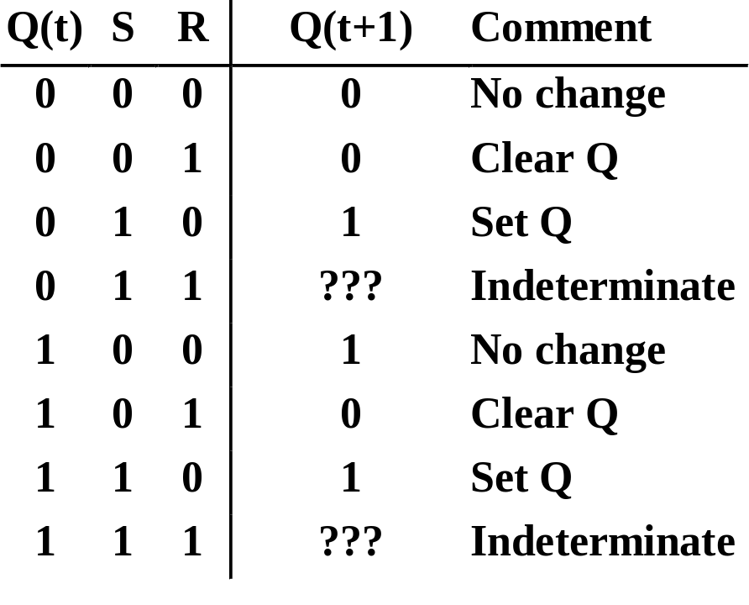
Clocked S - R Latch (continued)
The Clocked S-R Latch can be described by a table:
The table describes
what happens after the
clock [at time (t+1)]
based on:
  current inputs (S,R) and
  current state Q(t).
S
Q
C
Q
R
Chapter 5 - Part 1 <number>

Slide 17

D Latch
Adding an inverter
to the S-R Latch,
gives the D Latch:
Note that there are
no “indeterminate”
states!
D
Q
C
Q
Q
D
Q(t+1)
Comment
0
0
0
No change
D
Q
0
1
1
Set Q
1
0
0
Clear Q
C
Q
1
1
1
No Change
Chapter 5 - Part 1 <number>

Slide 18
Flip-Flops
The latch timing problem
Master-slave flip-flop
Edge-triggered flip-flop
Standard symbols for storage elements
Direct inputs to flip-flops
Chapter 5 - Part 1 <number>

Slide 19
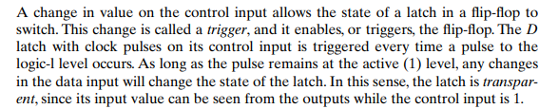
The Latch Timing Problem
Chapter 5 - Part 1 <number>

Slide 20

The Latch Timing Problem
Note that the problem with the latch is that it is transparent: As soon as an input changes, shortly thereafter the corresponding output changes to match it. This transparency is what allows a change on a latch output to produce additional changes at other latch outputs while the clock pulse is at logic 1. The key to the proper operation of flip-flops is to prevent them from being transparent. In a flipflop, before an output can change, the path from its inputs to its outputs is broken.
Chapter 5 - Part 1 <number>

Slide 21
The Latch Timing Problem
In a sequential circuit, paths may exist through combinational logic:
  From one storage element to another
  From a storage element back to the same storage element
The combinational logic between a latch output and a latch input may be as simple as an interconnect
For a clocked D-latch, the output Q depends on the input D whenever the clock input C has value 1
Chapter 5 - Part 1 <number>

Slide 22
The Latch Timing Problem (continued)
Consider the following circuit:
Suppose that initially Y = 0.
As long as C = 1, the value of Y continues to change!
The changes are based on the delay present on the loop through the connection from Y back to Y.
This behavior is clearly unacceptable.
Desired behavior: Y changes only once per clock pulse
Y
D
Q
Clock
C
Q
Clock
Y
Chapter 5 - Part 1 <number>

Slide 23
The Latch Timing Problem (continued)
A solution to the latch timing problem is to break the closed path from Y to Y within the storage element
The commonly-used, path-breaking solutions replace the clocked D-latch with:
  a master-slave flip-flop
  an edge-triggered flip-flop
Chapter 5 - Part 1 <number>

Slide 24
S-R Master-Slave Flip-Flop
Consists of two clocked
S-R latches in series
with the clock on the
second latch inverted
The input is observed
by the first latch with C = 1
The output is changed by the second latch with C = 0
The path from input to output is broken by the difference in clocking values (C = 1 and C = 0).
The behavior demonstrated by the example with D driven by Y given previously is prevented since the clock must change from 1 to 0 before a change in Y based on D can occur.
S
S
Q
S
Q
Q
C
C
C
R
R
Q
R
Q
Q
Chapter 5 - Part 1 <number>

Slide 25
Flip-Flop Problem
The change in the flip-flop output is delayed by the pulse width which makes the circuit slower or
S and/or R are permitted to change while C = 1
  Suppose Q = 0 and S goes to 1 and then back to 0 with R remaining at 0
    The master latch sets to 1
    A 1 is transferred to the slave
  Suppose Q = 0 and S goes to 1 and back to 0 and R goes to 1 and back to 0
    The master latch sets and then resets
    A 0 is transferred to the slave
  This behavior is called 1s catching
Chapter 5 - Part 1 <number>

Slide 26
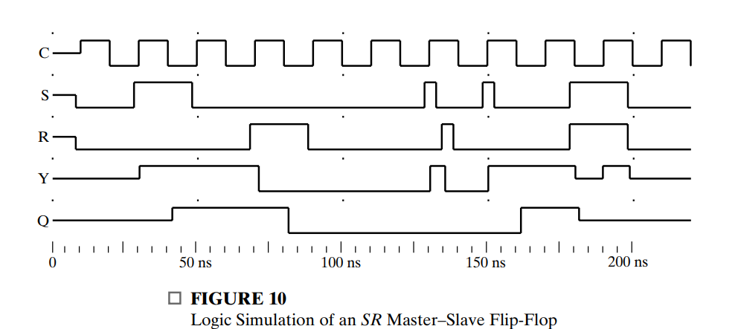
Flip-Flop Problem
Chapter 5 - Part 1 <number>
Notes:
A narrow pulse to 1 occurs on S at the beginning of a clock pulse. The master latch responds to the 1 on S by changing Y to 1. Then S goes to 0 and a narrow 1 pulse occurs on R. The master latch responds to the 1 on R by changing Y back to 0. Since there are no further 1 values on S or R, the master continues to store 0, which is copied to the slave latch, changing Q to 0, in response to the clock’s change to 0. Thus, the master latch “caught” both the 1 on S and the 1 on R. Since the 1 on R was caught last, the output Q remained at 0. In general, the “correct” response is assumed to be the response to the input values when the clock goes to 0.

Slide 27
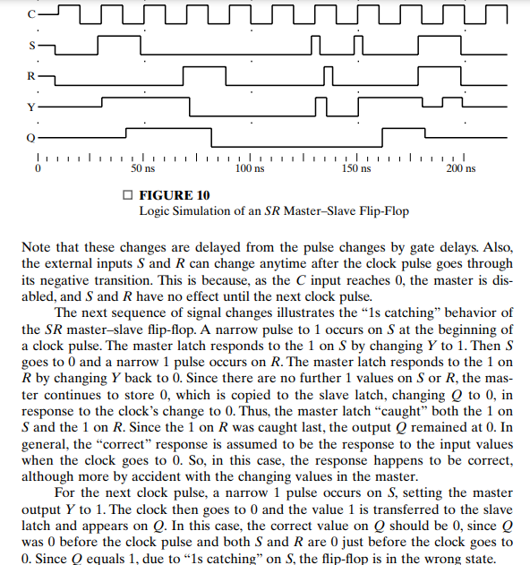
Flip-Flop Problem
Chapter 5 - Part 1 <number>

Slide 28
Flip-Flop Solution
Use edge-triggering instead of master-slave
An edge-triggered flip-flop ignores the pulse while it is at a constant level and triggers only during a transition of the clock signal
Edge-triggered flip-flops can be built directly at the electronic circuit level, or
A master-slave D flip-flop which also exhibits edge-triggered behavior can be used.
Chapter 5 - Part 1 <number>

Slide 29
Edge-Triggered D Flip-Flop
The edge-triggered
D flip-flop is the
same as the master-
slave D flip-flop
It can be formed by:
  Replacing the first clocked S-R latch with a clocked D latch or
  Adding a D input and inverter to a master-slave S-R flip-flop
The delay of the S-R master-slave flip-flop can be avoided since the 1s-catching behavior is not present with D replacing S and R inputs
The change of the D flip-flop output is associated with the negative edge at the end of the pulse
It is called a negative-edge triggered flip-flop
D
D
Q
S
Q
Q
C
C
C
Q
R
Q
Q
Chapter 5 - Part 1 <number>

Slide 30
Positive-Edge Triggered D Flip-Flop
Formed by
adding inverter
to clock input
Q changes to the value on D applied at the positive clock edge within timing constraints to be specified
Our choice as the standard flip-flop for most sequential circuits
D
D
Q
S
Q
Q
C
C
C
Q
R
Q
Q
Chapter 5 - Part 1 <number>

Slide 31
Standard Symbols for Storage Elements
Master-Slave:
Postponed output
indicators
Edge-Triggered:
Dynamic
indicator
S
S
D
D
R
R
C
C
SR
SR
D with 1 Control
D with 0 Control
(a) Latches
S
S
D
D
C
C
R
R
C
C
Triggered SR
Triggered SR
Triggered D
Triggered D
(b) Master-Slave Flip-Flops
D
D
C
C
Triggered D
Triggered D
(c) Edge-Triggered Flip-Flops
Chapter 5 - Part 1 <number>

Slide 32
Direct Inputs
At power up or at reset, all or part
of a sequential circuit usually is
initialized to a known state before
it begins operation
This initialization is often done
outside of the clocked behavior
of the circuit, i.e., asynchronously.
Direct R and/or S inputs that control the state of the latches within the flip-flops are used for this initialization.
For the example flip-flop shown
  0 applied to R resets the flip-flop to the 0 state
  0 applied to S sets the flip-flop to the 1 state
S
D
Q
C
Q
R
Chapter 5 - Part 1 <number>

Slide 33
Sequential Circuit Analysis
General Model
  Current State
  at time (t) is stored in an array of
  flip-flops.
  Next State at time (t+1) is a Boolean function of State and Inputs.
  Outputs at time (t) are a Boolean function of State (t) and (sometimes) Inputs (t).
Inputs
Outputs
Combina-tional
Logic
Storage Elements
Next
State
State
CLK
Chapter 5 - Part 1 <number>

Slide 34
Example 1 (from Fig. 5-15)
Input: x(t)
Output: y(t)
State: (A(t), B(t))
What is the Output Function?
What is the Next State Function?
x
D
Q
A
C
Q
A
D
Q
B
CP
C
Q
y
Chapter 5 - Part 1 <number>

Slide 35
Example 1 (from Fig. 5-15) (continued)
Boolean equations for the functions:
  A(t+1) = A(t)x(t) + B(t)x(t)
  B(t+1) = A(t)x(t)
  y(t) = x(t)(B(t) + A(t))
x
Q
A
D
C
Q
A
Next State
D
Q
B
CP
C
Q'
y
Output
Chapter 5 - Part 1 <number>

Slide 36
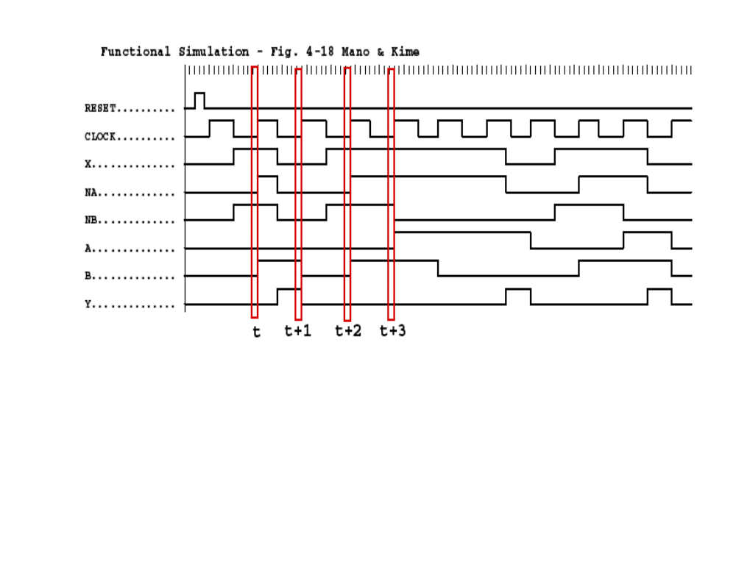
Example 1(from Fig. 5-15) (continued)
Where in time are inputs, outputs and states defined?
1
0
1
0
0
0
1
0
Chapter 5 - Part 1 <number>

Slide 37
State Table Characteristics
State table – a multiple variable table with the following four sections:
  Present State – the values of the state variables for each allowed state.
  Input – the input combinations allowed.
  Next-state – the value of the state at time (t+1) based on the present state and the input.
  Output – the value of the output as a function of the present state and (sometimes) the input.
From the viewpoint of a truth table:
  the inputs are Input, Present State
  and the outputs are Output, Next State
Chapter 5 - Part 1 <number>

Slide 38
Example 1: State Table (from Fig. 5-15)
The state table can be filled in using the next state and output equations: A(t+1) = A(t)x(t) + B(t)x(t) B(t+1) =‾A (t)x(t) y(t) =‾x (t)(B(t) + A(t))
Present State
Input
Next State
Output
A(t) B(t)
x(t)
A(t+1) B(t+1)
y(t)
0 0
0
0 0
0
0 0
1
0 1
0
0 1
0
0 0
1
0 1
1
1 1
0
1 0
0
0 0
1
1 0
1
1 0
0
1 1
0
0 0
1
1
1
1
1 0
0
Chapter 5 - Part 1 <number>

Slide 39
Example 1: Alternate State Table
2-dimensional table that matches well to a K-map. Present state rows and input columns in Gray code order.
  A(t+1) = A(t)x(t) + B(t)x(t)
  B(t+1) =‾A (t)x(t)
  y(t) =‾x (t)(B(t) + A(t))
Present
Next State
Output
State
x(t)=0 x(t)=1
x(t)=0 x(t)=1
A(t) B(t)
A(t+1)B(t+1) A(t+1)B(t+1)
y(t) y(t)
0 0
0 0 0 1
0 0
0 1
0 0 1 1
1 0
1 0
0 0
1 0
1 0
1 1
0 0 1 0
1 0
Chapter 5 - Part 1 <number>

Slide 40
State Diagrams
The sequential circuit function can be represented in graphical form as a state diagram with the following components:
  A circle with the state name in it for each state
  A directed arc from the Present State to the Next State for each state transition
  A label on each directed arc with the Input values which causes the state transition, and
  A label:
    On each circle with the output value produced, or
    On each directed arc with the output value produced.
Chapter 5 - Part 1 <number>

Slide 41
State Diagrams
Label form:
  On circle with output included:
    state/output
    Moore type output depends only on state
  On directed arc with the output included:
    input/output
    Mealy type output depends on state and input
Chapter 5 - Part 1 <number>

Slide 42
Example 1: State Diagram
x=0/y=0
x=0/y=1
Which type?
Diagram gets
confusing for
large circuits
For small circuits,
usually easier to
understand than
the state table
x=1/y=0
A B
0 0
x=0/y=1
1 0
x=1/y=0
x=1/y=0
x=0/y=1
0 1
1 1
x=1/y=0
Chapter 5 - Part 1 <number>
Notes:
Type: Mealy

Slide 43
Equivalent State Definitions
Two states are equivalent if their response for each possible input sequence is an identical output sequence.
Alternatively, two states are equivalent if their outputs produced for each input symbol is identical and their next states for each input symbol are the same or equivalent.
Chapter 5 - Part 1 <number>

Slide 44
Equivalent State Example
0
Text Figure 5-17(a):
For states S3 and S2,
  the output for input
  0 is 1 and input 1 is 0,
  and
  the next state for input
  0 is S0 and for input
  1 is S2.
  By the alternative definition, states S3 and S2 are equivalent.
1
S0/0
S1
0/1
0/1
0/1
1/0
1/0
S2
S3
1/0
Chapter 5 - Part 1 <number>

Slide 45
Equivalent State Example
0/0
1/0
Replacing S3 and S2
by a single state gives
state diagram:
Examining the new diagram,
states S1 and S2 are equivalent since
  their outputs for input
  0 is 1 and input 1 is 0,
  and
  their next state for input
  0 is S0 and for input
  1 is S2,
Replacing S1 and S2 by a
single state gives state
diagram:
S0
S1
0/1
0/1
1/0
S2
1/0
0/0
1/0
S0
S1
0/1
1/0
Chapter 5 - Part 1 <number>

Slide 46
Moore and Mealy Models
Sequential Circuits or Sequential Machines are also called Finite State Machines (FSMs). Two formal models exist:
Moore Model
  Named after E.F. Moore
  Outputs are a function ONLY of states
  Usually specified on the states.
Mealy Model
  Named after G. Mealy
  Outputs are a function of inputs AND states
  Usually specified on the state transition arcs.
Chapter 5 - Part 1 <number>

Slide 47
Moore and Mealy Example Diagrams
Mealy Model State Diagram
maps inputs and state to outputs
Moore Model State Diagram maps states to outputs
x=1/y=0
x=0/y=0
0
1
x=0/y=0
x=1/y=1
x=0
0/0
x=0
x=1
x=1
x=0
1/0
2/1
x=1
Chapter 5 - Part 1 <number>

Slide 48
Moore and Mealy Example Tables
Moore Model state table maps state to outputs
Mealy Model state table maps inputs and state to outputs
Present
Next State
Output
State
x=0 x=1
0
0 1
0
1
0 2
0
2
0 2
1
Present
Next State
Output
State
x=0 x=1
x=0 x=1
0
0 1
0 0
1
0 1
0 1
Chapter 5 - Part 1 <number>

Slide 49
Mixed Moore and Mealy Outputs
In real designs, some outputs may be Moore type and other outputs may be Mealy type.
Example: Figure 5-17(a) can be modified to illustrate this
  State 00: Moore
  States 01, 10,
  and 11: Mealy
Simplifies output
specification
0
1
00/0
01
0/1
0/1
0/1
1/0
1/0
10
11
1/0
Chapter 5 - Part 1 <number>

Slide 50
Example 2: Sequential Circuit Analysis
A
Logic Diagram:
D
Q
Z
C
R
Q
B
D
Q
C
R
Q
C
D
Q
Clock
C
R
Q
Reset
Chapter 5 - Part 1 <number>

Slide 51
Example 2: Flip-Flop Input Equations
Variables
  Inputs: None
  Outputs: Z
  State Variables: A, B, C
Initialization: Reset to (0,0,0)
Equations
  A(t+1) = Z =
  B(t+1) =
  C(t+1) =
Chapter 5 - Part 1 <number>
Notes:
A(t+1) = BC
B(t+1) = B’C + BC’
C(t+1) = A’C’
Z = A

Slide 52
Example 2: State Table
X’ = X(t+1)
A B C | A’B’C’ | Z
0 0 0
0 0 1
0 1 0
0 1 1
1 0 0
1 0 1
1 1 0
1 1 1
Chapter 5 - Part 1 <number>
Notes:
A’B’C’: 0 0 1, 0 1 0, 0 1 1, 1 0 0, 0 0 0, 0 1 0, 0 1 0, 1 0 0
Z: 0 0 0 0 1 1 1 1

Slide 53
Example 2: State Diagram
Which states are used?
What is the function of
the circuit?
ABC
Reset
000
111
100
001
011
010
101
110
Chapter 5 - Part 1 <number>
Notes:
Only states reachable from the reset state 000 are used: 000, 001, 010, 011, and 100.
The circuit produces a 1 on Z after four clock periods and every five clock periods thereafter:
000 -> 001 -> 010 -> 011 -> 100 -> 000 -> 001 -> 010 -> 011 -> 100 …
1 1

Slide 54
Terms of Use
All (or portions) of this material © 2008 by Pearson Education, Inc.
Permission is given to incorporate this material or adaptations thereof into classroom presentations and handouts to instructors in courses adopting the latest edition of Logic and Computer Design Fundamentals as the course textbook.
These materials or adaptations thereof are not to be sold or otherwise offered for consideration.
This Terms of Use slide or page is to be included within the original materials or any adaptations thereof.
Chapter 5 - Part 1 <number>

